Slide 1
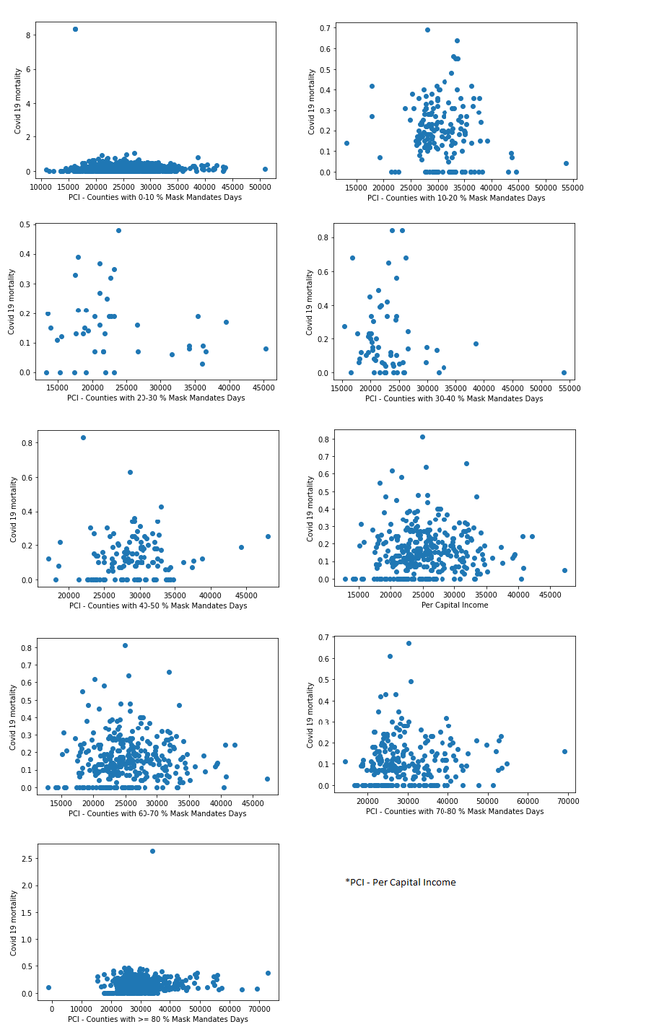
Exhaustive 3-dimensional Analysis to comparatively quantify the beneficial effects of Mask Mandates, weighted against per capital income of respective US localities. – Tunde Adefokun
Core Objective: To answer the question: Did a factor like per capital income contribute to the effectiveness of Mask Mandates or it never mattered at all so long as Mask Mandates were uniformly enforced in the local population?
Conclusion: After grouping all counties in the United States into 9 clusters based on their depth of Mask Mandate commitments and analyzing each group by comparing mean incomes per county with Covid 19-related mortality rates, there seemed to be no tangible relationship between Per Capital Income (PCI) and Mask Mandates, as shown by the scatter plots below.

